Slide 1
Mobile Apps

Slide 2
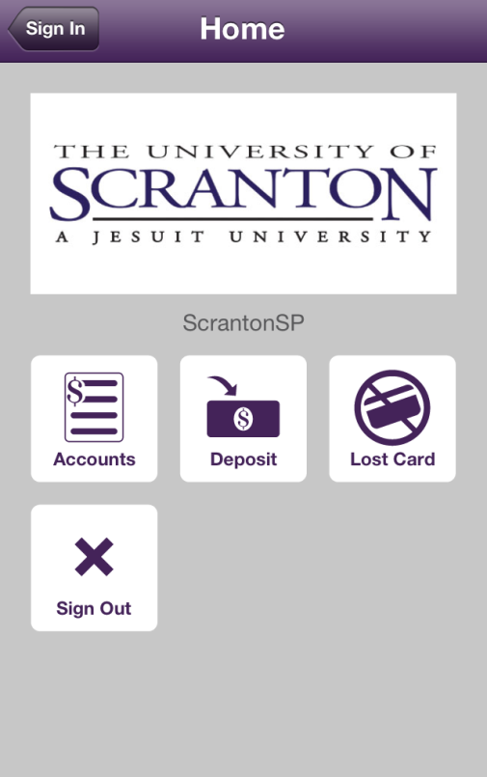
Vendor Apps In Use Today
eAccounts (for RoyalCard) – Blackboard
ANGEL Mobile – Blackboard

Slide 3
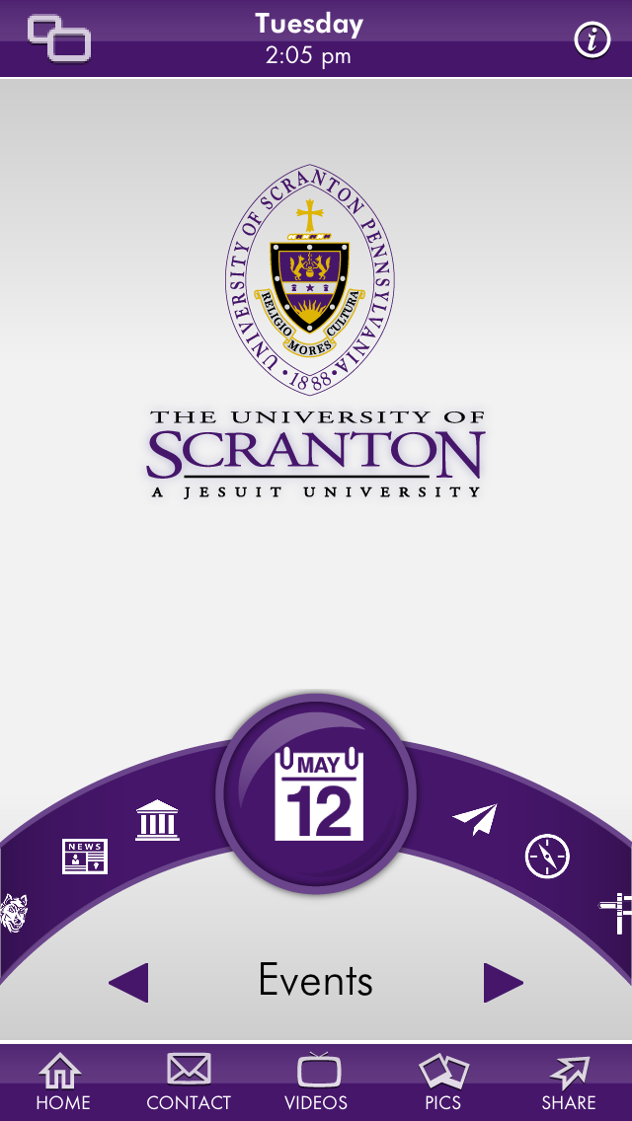
University Apps
The Scranton App – by Straxis
Student Services App – by ITDA

Slide 4
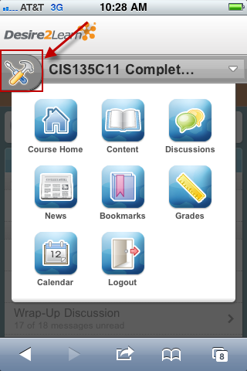
Responsive Web Apps
OrgSync (RoyalSync)
Desire2Learn
Note: D2L also has 2 special purpose apps – Binder and Grader

Slide 5
The Scranton App
Features
Campus News
Admissions (Find Counselor, Admissions Events, Request Information)
Athletics (Sports Headlines, Sports)
Events
Emergency (Call for Assistance, Emergency Resources)
Campus Map
Campus Tour
Multimedia
References (Directions, Academic Calendar, HR, COLTS Connection)
Courses (Academic Catalogs)
Bulletins(RoyalNews)
Checklist (Visit Scranton Checklist, Senior Year Checklist, Becoming Alumni)
Polls
Radio
Weather
Twitter
Links (Facebook, Foursquare)
Directory(Department Contacts Onl)
Alumni (News, Events, Reunion, Get Involved, Members, Links)
Library (Ask Librarian, Hours, Blog, about Library)
Facebook

Slide 6
Student Services Mobile Web App
Features
Check Grades
View Full Schedule
View Finals Schedule
View Channel Guide
Visit the Aquinas
Visit the Library (Reserve a Group Study Room, Search Catalog, Ask a Librarian, Hours, News, Staff, Hours)
Accessible at m.scranton.edu
or Scranton App

Slide 7
What Else Do We Need?
2011 Survey/ Mobile Apps Working Group
Register for Classes
Dining Services Menu
Laundry View Status
Computer Lab Availability
Gym Schedule
Housing Lottery
Orientation Schedule
Chat with various Campus Offices
ECAR Results (Student Desires)

Slide 8
What Else Do You Think We Need?
Work study – Financial aid balance; time sheet (Self-Service Banner)
Evaluate what’s being used most in SSB, and target those functions
Wireless printing (residence halls – looking at upgrading – security is an issue; library – upgrade to Uniprint)
Upgrade the mobile catalog search that’s on m.scranton.edu library home page

